Slide 1
What is a CGR
Is a way to make sure that, at parish level, governance arrangements are working as efficiently and effectively as they should be.
This is achieved by asking the public, parish councils and any interested parties whether they feel their communities are suitably represented and whether parish councils would like to see any changes made to their current governance arrangements.
The aim of a review is to consider and bring about improved community engagement, better local democracy and efficient, more effective and convenient delivery of local services and ensures electors across these Parishes are treated equitably and fairly

Slide 2
What triggers a CGR?
We have the power to undertake such reviews under Part 4 of the Local Government and Public Involvement in Health Act 2007 and the relevant national guidance document
Guidance = 10 to 15 years but CBC council 5-10 due to development
Petition by a parish

Slide 3
What can a Community Governance Review do?
Create, merge, alter or abolish parishes;
Change electoral arrangements for parishes including the ordinary year of an election, number of parish councillors and changes to parish wards;
Convert a parish council to a parish meeting;
Change the name or the style of a new parish/town council or parish meeting; and
Group parishes together under a common parish
Amend boundary anomalies

Slide 4
What can’t a Community Governance Review do?
Change the number of district or county councillors;
Change a district (external)or county council ward boundaries;
Change the amount of money that a parish council raises through your council tax (known as ‘precept’);
Change individual parish councillors; and
Create a unitary authority.

Slide 5
A CGR must –
Reflect the identities and interests of the communities in that area, and
Be effective and convenient.
Consequently, a CGR must take into account –
The impact of community governance arrangements on community cohesion, and
The size, population and boundaries of a local community or parish.

Slide 6
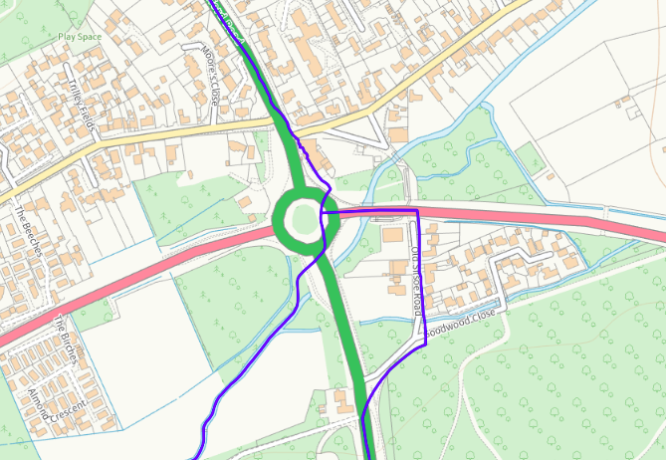
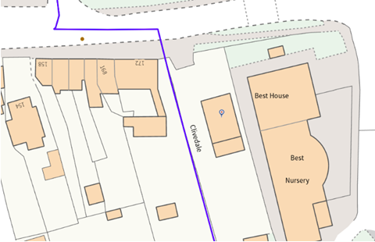
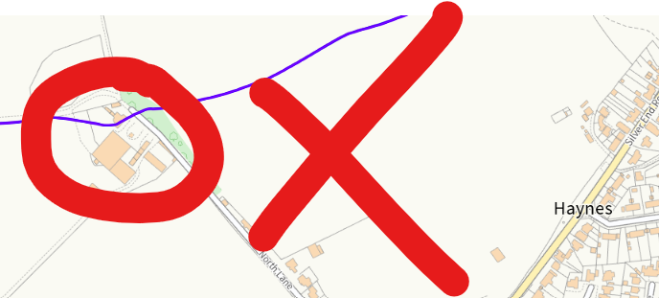
Examples:
Internal Parish Boundaries can be moved.
External boundaries can not be moved in a CGR and require a Principal area review.

Slide 7
What now?
Check your existing Parish Boundary
Engage with your residents
Engage with your neighbouring parishes if you are looking to change boundaries – having joint approval before submitting your recommendations will improve your case.
Remember your legal authority when suggesting a reason for a change – Parishes do not pay for schools/highways/buses/doctors….

Slide 8
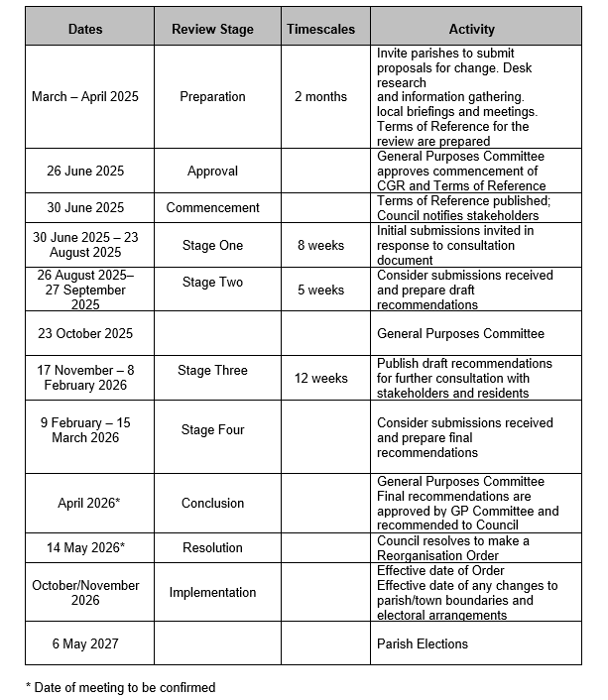
Terms of Reference - Timetable

